Slide 1
How do you tame a big ball of mud?
One test at a time.
Matt Eland
@IntegerMan
https://www.Linkedin.com/in/MattEland/
Slides and code available at: https://GitHub.com/IntegerMan/SoftwareQualityTalk/

Slide 2

About Me
For fun since 1987
In .NET since 2001
Skillset
Programming
Professionally since 2006
Contact Info
@IntegerMan
LinkedIn/in/MattEland
Matt.Eland@GMail.com
Full Stack .NET
TypeScript / Angular
Application Development
Management / Mentoring
Slides and code available at: https://GitHub.com/IntegerMan/SoftwareQualityTalk/

Slide 3
My Background
Software Engineer
Verizon Business
Software Developer
Exceptional Innovation
Senior Engineer
TeamDynamix
Software Engineering Manager
MoveHQ

Slide 4
About This Talk
Intended to introduce variety of tools and ideas to give you options when working with legacy code
Unit Testing 101
.NET Libraries useful for improving tests
Other Ideas for Improving Quality
Conclusion Q&A Community Ideas

Slide 5

This Talk Is NOT
Focused on any particular .NET project type
ASP .NET, XAML, Web API etc
Focused extensively on any one library or tool
Code-Intensive
Solely about unit testing
403 FORBIDDEN

Slide 6
It’s a Legacy System!
With Over 50k lines of code and 0 tests
And we need you to add this new feature…

Slide 7
Your New Codebase: Resume Scoring Algorithm
Resume Information
System
Under Test
Resume Score

Slide 8


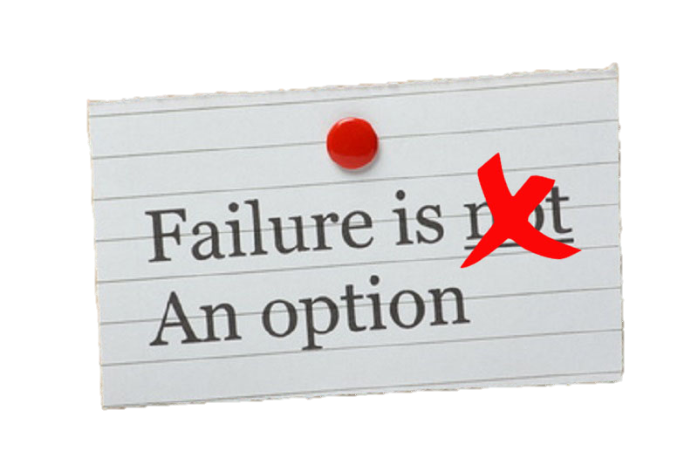


What Do You Do?

Slide 9

Build your own Safety Net

Slide 10
Unit Testing 101

Slide 11
Types of Tests
Integration Tests
Manual
Unit / Component Tests
UI Automation
Exploratory

Slide 12
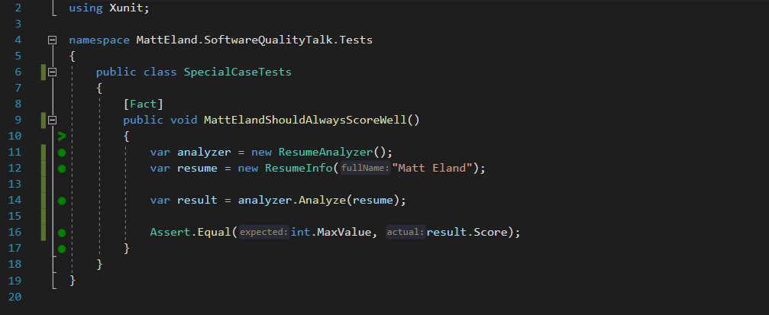
What is a Unit Test?

Slide 13
What is a Unit Test? – Detected by Attribute

Slide 14
What is a Unit Test? – Exercises System Under Test

Slide 15
What is a Unit Test? – Contains Assertions

Slide 16
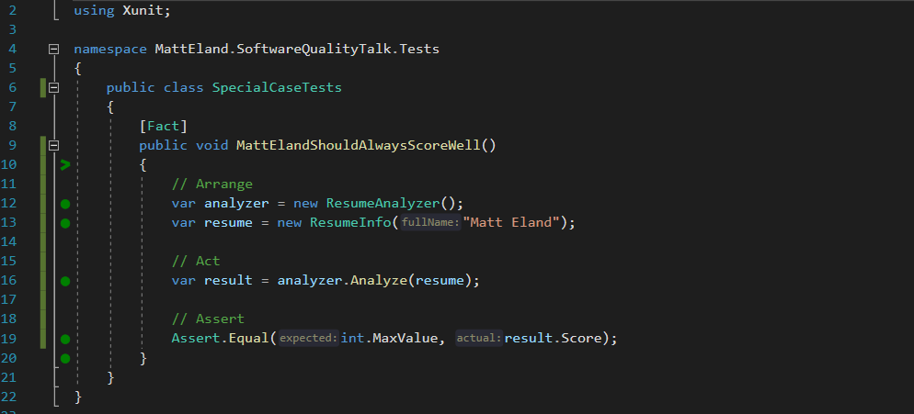
What is a Unit Test? – Arrange / Act / Assert

Slide 17
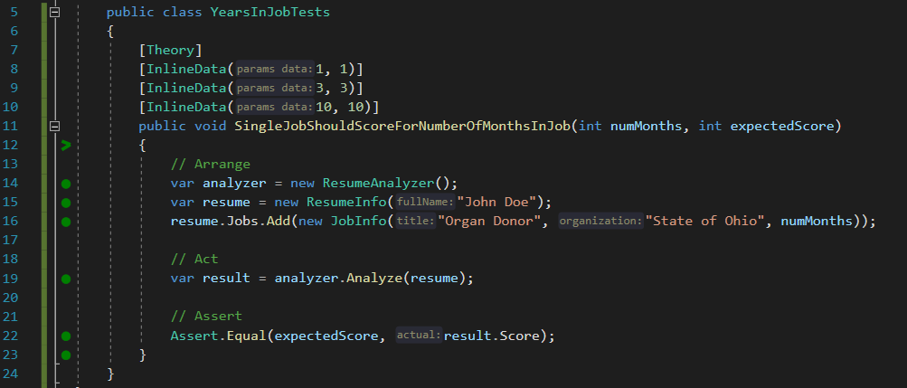
Parameterized Unit Tests

Slide 18



Unit Testing Frameworks
MSTest
NUnit
XUnit
Already installed in Visual Studio
[TestMethod] / [DataTestMethod]
MSTest2 closes gaps the original had
Port of frameworks like Junit
[Test] / [TestCase]
Often more integration support
More recent addition
[Fact] / [Theory]
More favored in .NET Core
See https://raygun.com/blog/unit-testing-frameworks-c/ for detailed analysis of different frameworks

Slide 19
Test Driven Development (TDD)
Green
Clean up System Under Test
Red
Write a failing test
Make the test pass
Refactor

Slide 20

But I can’t test my code because _______________ !

Slide 21
But I can’t test my code because _______________ !
it works with the UI
Some options:
Then don’t write tests for it.
Make the view layer as small and dumb as possible, then test the rest
Selenium tests for web / Coded UI tests for desktop

Slide 22
But I can’t test my code because _______________ !
Database Dependencies
Some options:
Remove the database dependency via Dependency Injection
Use Entity Framework and in-memory database tests
Keep talking to the database, but work around the limitation

Slide 23
But I can’t test my code because _______________ !
it’s a big ball of mud
Some options:
Git Gud
Don’t test, but expect bugs in the legacy system when changes arise
Place some “pinning” tests, then refactor to a better architecture

Slide 24
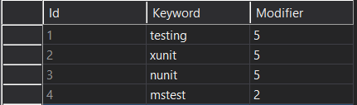
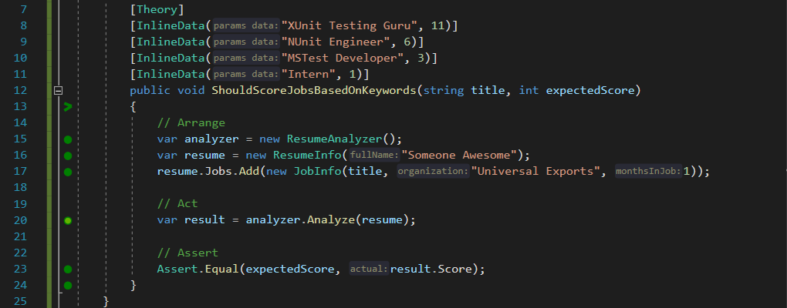
Removing Database Dependencies Example

Slide 25
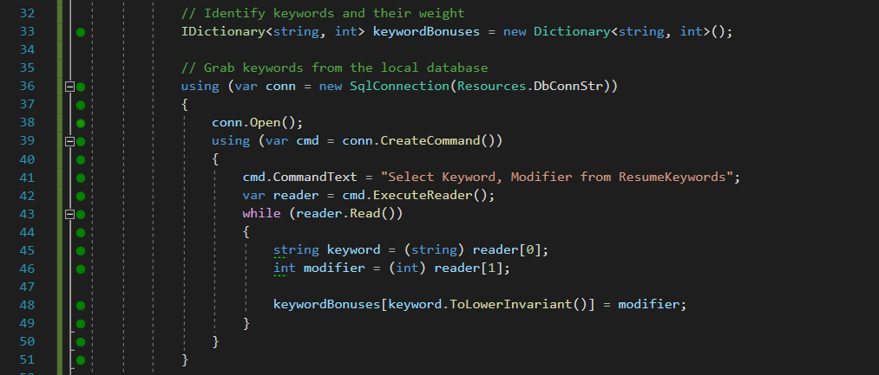
Removing Database Dependencies Example

Slide 26
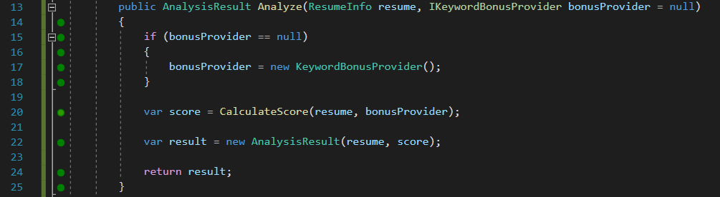
Removing Database Dependencies Example

Slide 27
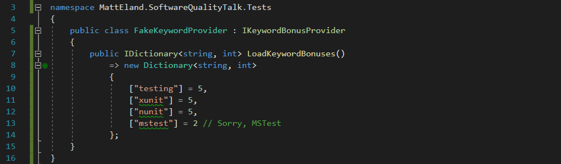
Removing Database Dependencies Example

Slide 28
Testing Libraries

Slide 29
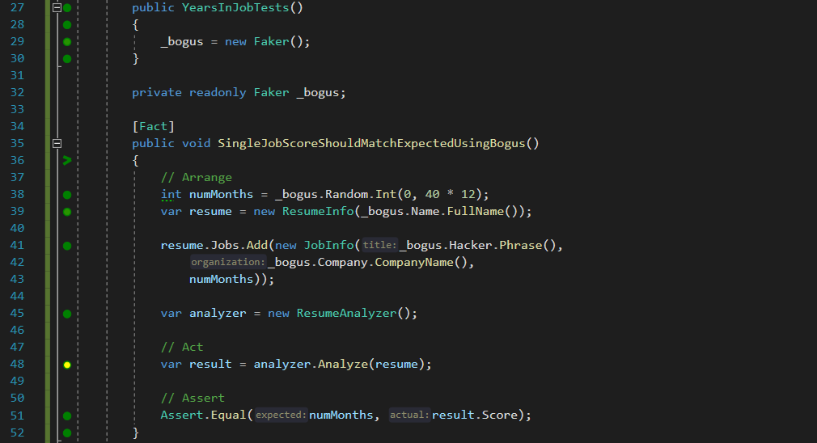
Generating Test Data with Bogus
Removes noise from values irrelevant from test data.
GitHub Repo: https://github.com/bchavez/Bogus

Slide 30
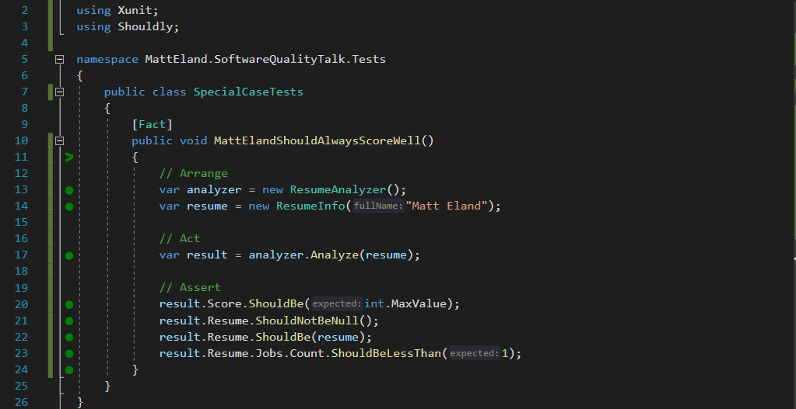
Shouldly
Nice and readable, plus I’ll never confuse actual and expected ordering again.
GitHub Repo: https://github.com/shouldly/shouldly

Slide 31
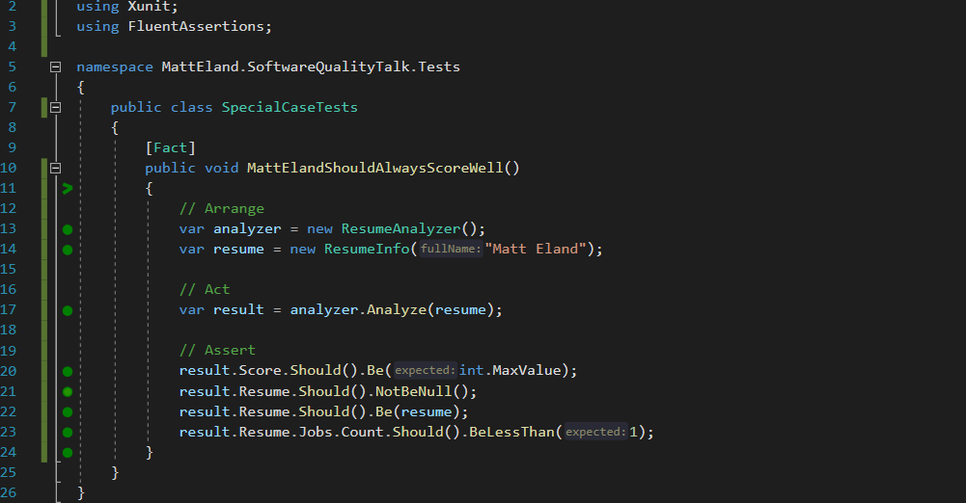
FluentAssertions
The same as Shouldly, except now with more parentheses
GitHub Repo: https://github.com/fluentassertions/fluentassertions

Slide 32
Finding Edge Cases with SharpFuzz

Slide 33
Comparing Logic with Scientist .NET

Slide 34
Testing State Trees with SnapShotter / ApprovalTests / Snapper

Slide 35
Moq to Create Mock Objects

Slide 36
Moq to Verify Behavior

Slide 37
AutoFixture

Slide 38
In Memory Tests with Entity Framework

Slide 39
JetBrains Annotations / Code Contracts

Slide 40
Functional Programming

Slide 41
Behavior Driven Development with SpecFlow

Slide 42
Other Recipes

Slide 43
User Interface Testing
Selinium
Katalon Recorder

Slide 44

Code Reviews
All Code is Peer Reviewed before testing occurs
Reviews can be informal to extremely formal
Best results if
Authors review their own code before submitting
Reviewers make multiple “themed” passes
Tracked via a system

Slide 45
CI/CD Pipeline Integration
Restore Dependencies
Build
Run Tests
Run Code Analysis
Publish Results
Track metrics over time
Integrate results into code review process
Should be repeatable
Notify on failure
Store build artifacts
Publish build status
Possibly deploy software
TeamCity: https://www.jetbrains.com/teamcity/

Slide 46
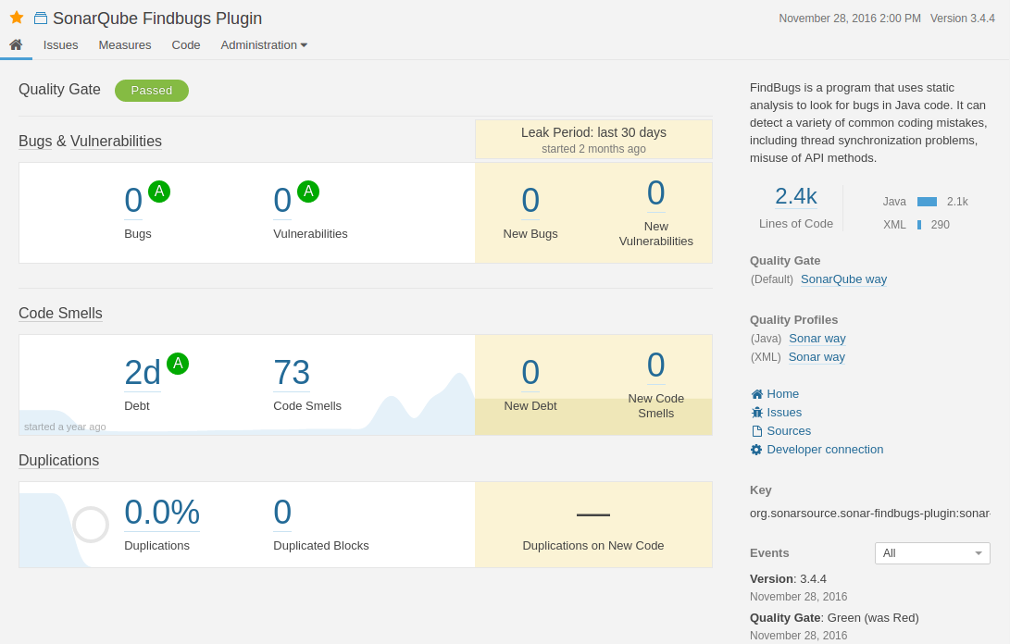
Code Analysis with SonarQube
SonarQube: https://www.sonarqube.org/

Slide 47
Postman Collections For API Testing

Slide 48
Fiddler for Discovering hidden Web Communications

Slide 49
Test Plans

Slide 50
NCrunch

Slide 51
Conclusion
Slides and Code Available At: Https://GitHub.Com/IntegerMan/SoftwareQualityTalk/

Slide 52
Key Takeaways
When facing a big ball of mud, write pinning tests first
Test code can be awesome too
Try this out!
Think what you need the most
Try a library that makes the most sense
See what works for your project
Slides and code available at: https://GitHub.com/IntegerMan/SoftwareQualityTalk/

Slide 53
Book Recommendations
Working Effectively with Legacy Code
Developer Testing
XUnit Test Patterns
Measuring the Software Process
The Practical Guide to Defect Prevention
Slides and code available at: https://GitHub.com/IntegerMan/SoftwareQualityTalk/

Slide 54
Questions? Other Quality Recipes?
Slides and Code Available at: Https://GitHub.Com/IntegerMan/SoftwareQualityTalk/

